Slide 1
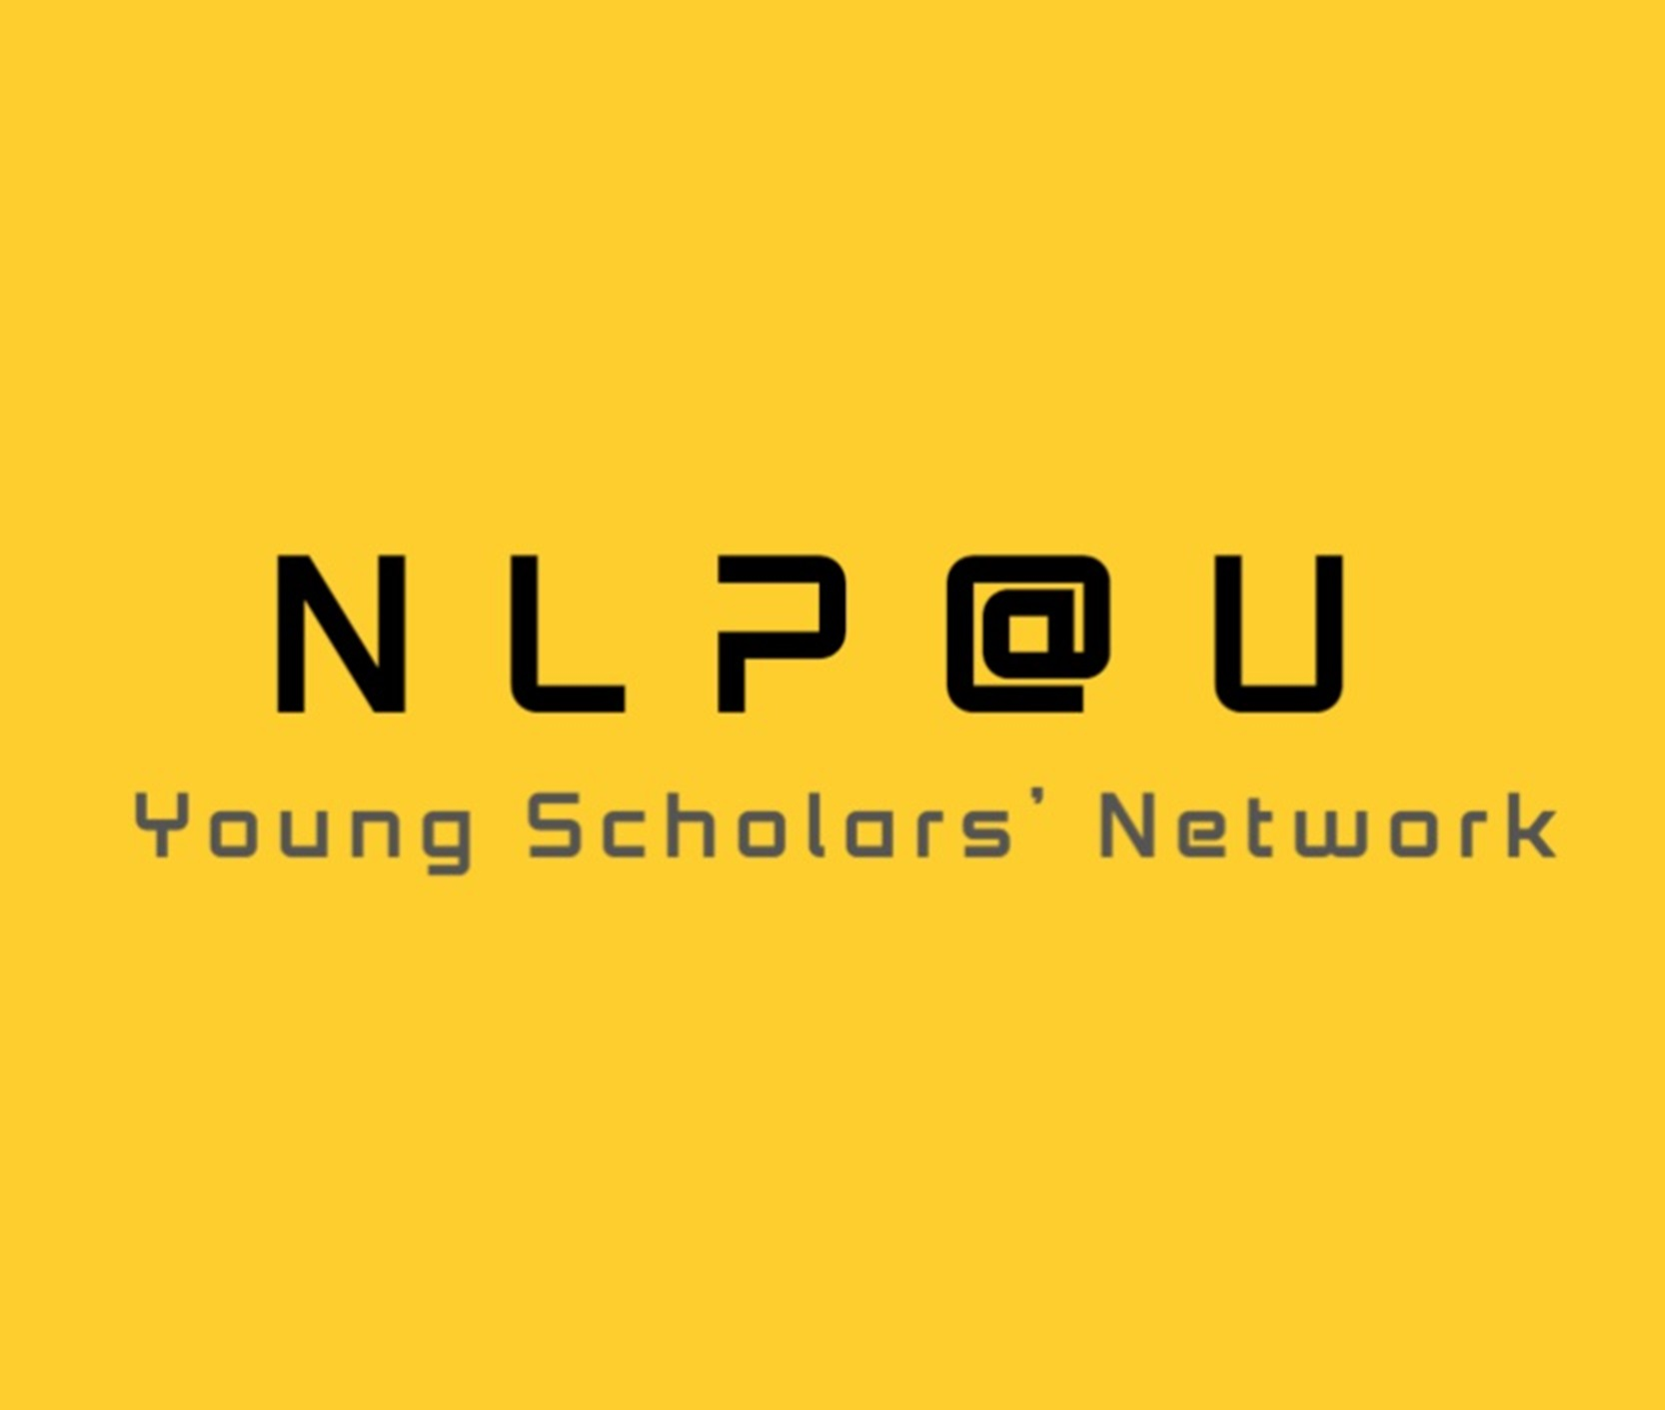

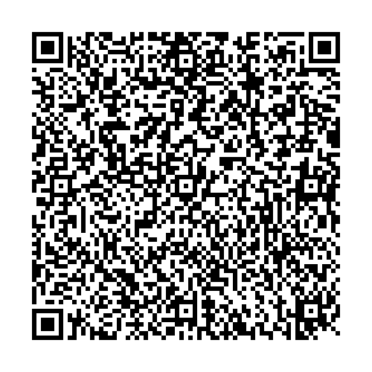
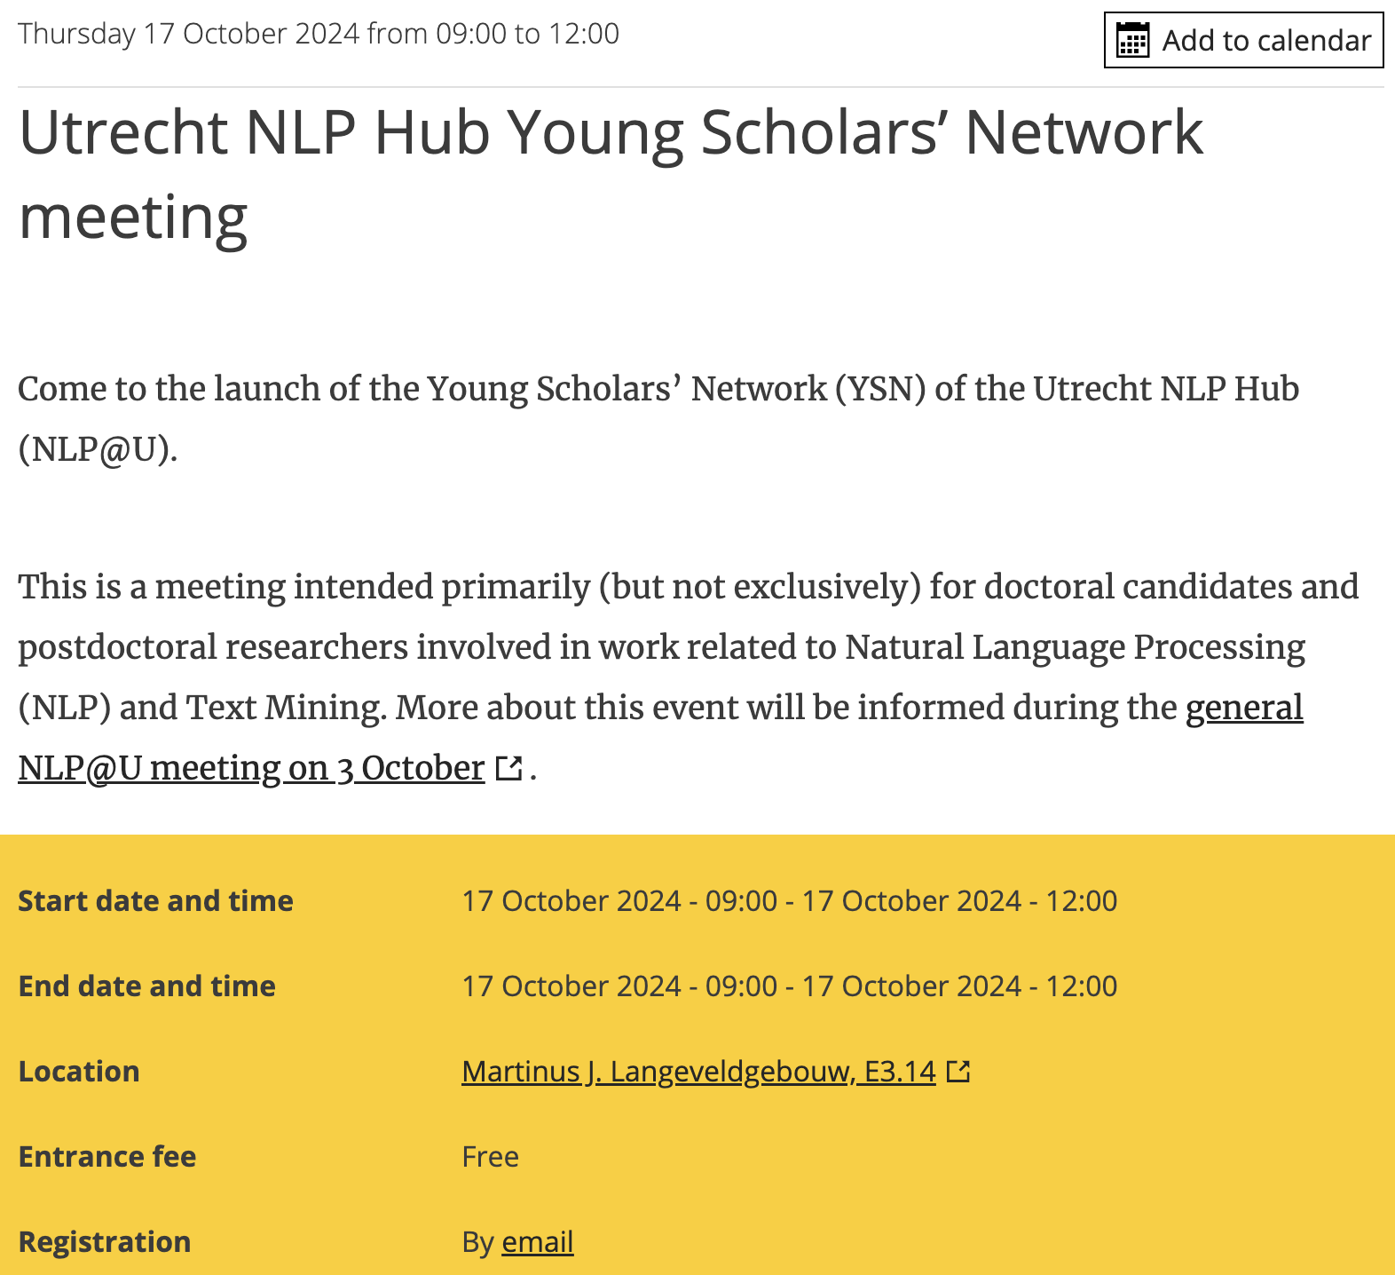
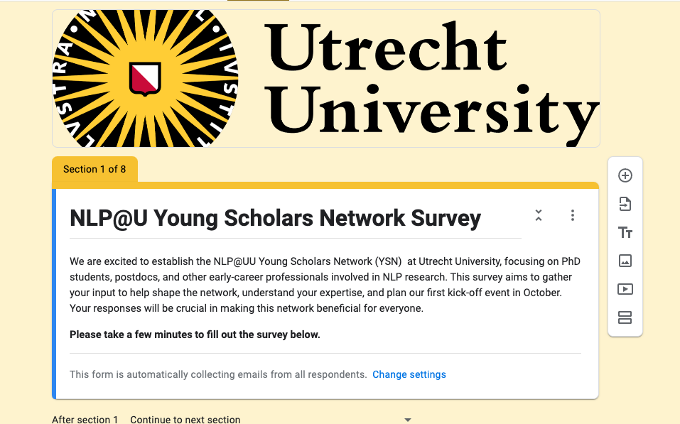
Introducing the NLP@U Young Scholars Network (YSN)
What is YSN? A collaborative community for PhD students, postdocs, and early-career researchers in Natural Language Processing (NLP) at UU and UMCU.
Mission & Goals:
Collaboration: Promote joint research and interdisciplinary work.
Networking: Connect NLP scholars across departments.
Knowledge Sharing: Share resources, best practices, and career tips.
Who Can Join? Open to all young NLP scholars at UU and UMCU.
Activities:
Teams channel established, website and blogs coming soon.
Survey to collect background and research interests.
First launch event: 17 October 2024.
Future events: networking, reading groups, presentations.
logo
Teams Channel
For more information, contact: h.mohammadi@uu.nl
kick off event
Survey

